Slide 1
Dossier of Evidence Why is it necessary to scale up hepatitis B and hepatitis C testing in Europe?

Slide 2
Content
Hepatitis B virus and hepatitis C virus: The Basics
Know Your Epidemics: The Situation of HBV and HCV in Europe
Late presentation for viral hepatitis
The Importance of Timely Diagnosis of HBV and HCV
Barriers to HBV and HCV Testing
Creating More Testing Opportunities
Conclusions

Slide 3
Hepatitis B virus and hepatitis C virus: The basics

Slide 4
What are HBV and HCV?
Hepatitis B virus (HBV) and hepatitis C virus (HCV) are both viruses that attack the liver
HBV and HCV cause:
Scarring of the liver tissue (cirrhosis)
Liver cancer
Liver failure
Death
HBV and HCV disease can progress unnoticed over many years
Increasingly worse liver damage without any outward signs
People might not feel ill until they have advanced disease

Slide 5
Hepatitis B Virus - HBV
May cause short-term (acute) illness followed by full recovery
May cause incurable chronic disease
Correlation between age of infection and likelihood of chronic disease:
Infected early in life = high risk of chronic disease
Infected in adulthood = low risk of chronic disease
Chronic HBV cannot be cured but there are treatments that slow disease progression and improve health outcomes

Slide 6
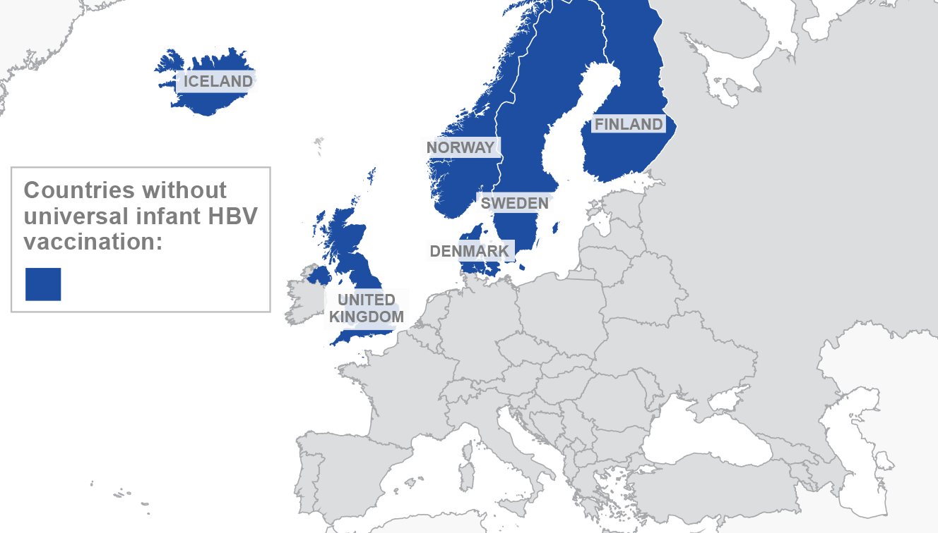
HBV
An effective HBV vaccine exists!
Many Member States of the World Health Organization European Region have universal infant HBV vaccination
Some do not, including in high-income countries of the European Union
Countries without universal infant HBV vaccination:

Slide 7
How is HBV transmitted?
HBV is spread through exposure to infected blood and other body fluids
Children born to HBV-infected mothers are at high risk if they do not receive timely vaccination
Other modes of transmission:
Sexual contact
Re-use of needles and syringes
Contaminated objects such as razors and tattooing equipment

Slide 8
Hepatitis C Virus - HCV
May cause short-term (acute) illness followed by full recovery
May cause long-term chronic disease
Chronic HCV:
Occurs in 55 – 85% of cases of infection
Is much more likely to occur in adults than in children
Persists for life unless treated successfully with anti-viral drugs
There is no vaccine against HCV
World Health Organization. Hepatitis C. WHO, 2019. Available here: https://www.who.int/news-room/fact-sheets/detail/hepatitis-c

Slide 9
HCV treatment
Has greatly improved in recent years
Newest drugs are all-oral and have very high cure rates (95%)

Slide 10
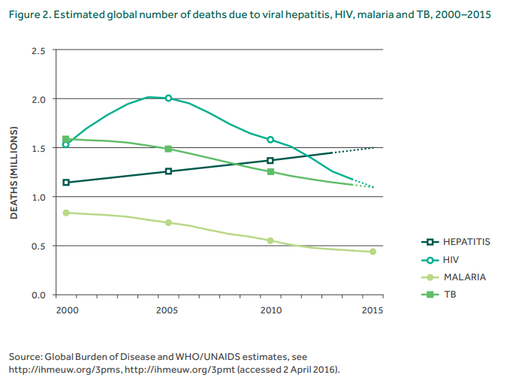
Global impact of HBV and HCV
Viral hepatitis is responsible for 1.4 million deaths per year from acute infection and hepatitis-related liver cancer and cirrhosis.
Of these deaths:
47% is due to HBV
48% is due to HCV
Source: World Health Organization. Global health sector strategy on viral hepatitis 2016-2021: Towards ending viral hepatitis. Geneva: WHO; 2016.

Slide 11
Know your epidemics: The situation of HBV and HCV in Europe

Slide 12
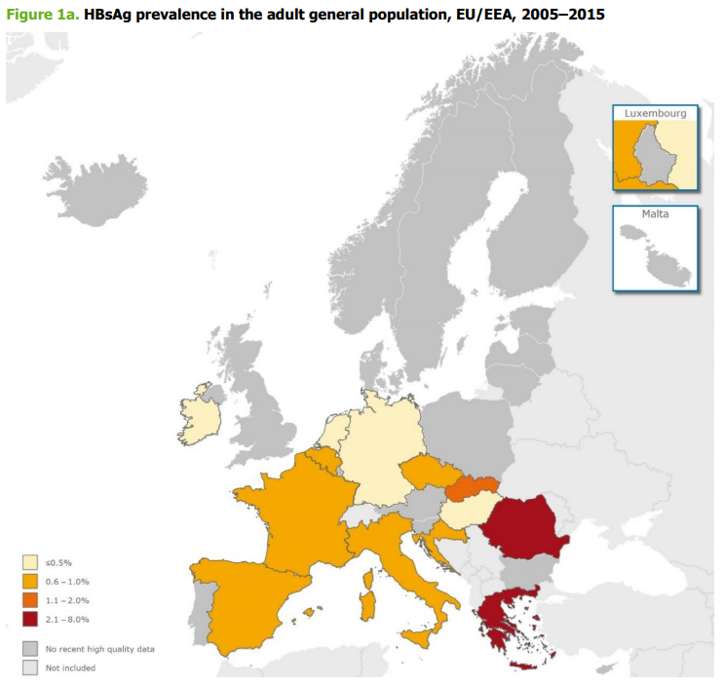
HBV in Europe
In the EU/EEA, the prevalence of HBV is estimated to be around 0.9% with a total of 4.7 million cases of chronic HBV.
Source: European Centre for Disease Prevention and Control. Systematic review on hepatitis B and C prevalence in the EU/EEA. Stockholm: ECDC; 2016.

Slide 13
HBV in Europe
HBV prevalence in countries with data representing the general population
Country | HBsAg prevalence (%)
Austria | -
Belgium | 0.6-0.7
Bulgaria | -
Croatia | 0.7-2.3
Cyprus | -
Czech Republic | 0.6
Denmark | -
Finland | -
France | 0.7-2.2
Germany | 0.3-0.7
Greece | 3.5-7.5
Hungary | 0.4
Iceland | -
Ireland | 0.1
Italy | 0.5-5.8
Country | HBsAg prevalence (%)
Latvia | -
Liechtenstein | -
Lithuania | -
Luxembourg | -
Malta | -
Netherlands | 0.2-0.7
Norway | -
Poland | 0.9-1.1
Portugal | -
Romania | 4.4-6.2
Slovakia | 1.1
Slovenia | -
Spain | 0.0-0.7
Sweden | -
United Kingdom | 1.7
Source: European Centre for Disease Prevention and Control. Hepatitis B and C epidemiology in selected population groups in the EU/EEA. Stockholm: ECDC; 2018.

Slide 14
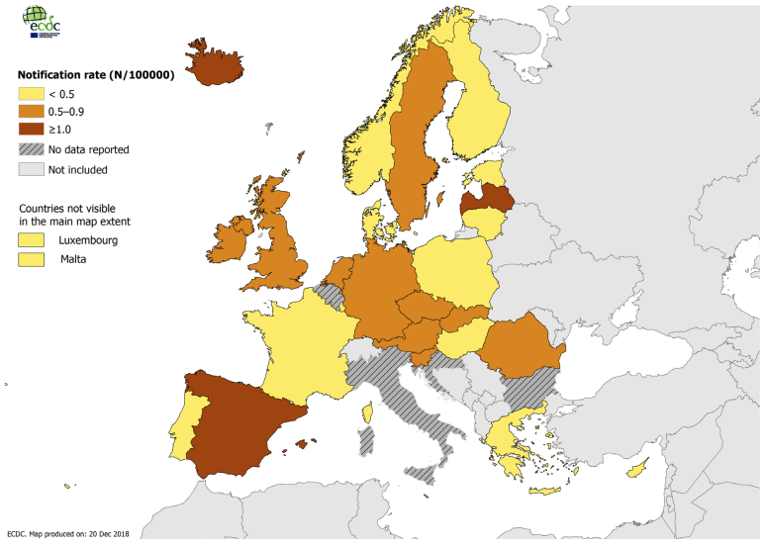
HBV in Europe
Notification rate of acute hepatitis B cases* per 100 000 population by country, EU/EEA, 2017
In 2017, 29 907 cases of hepatitis B virus infection were reported in 30 EU/EEA Member States. Of these cases, 9% were acute, 58% were chronic, 32% were ‘unknown,’ and 1% could not be classified.
Source: European Centre for Disease Prevention and Control. Hepatitis B. In: ECDC. Annual epidemiological report
for 2017. Stockholm: ECDC; 2019.
ECDC, Annual Epidemiological Report 2017 – Hepatitis B

Slide 15
HBV in Europe
High risk groups for acquiring an HBV or HCV infection include: people who require blood or blood products, people interned in prisons, people who inject drugs, people with multiple sexual partners, migrants originating from endemic regions, and new-borns from HBV or HCV chronically infected mothers (vertical transmission)
Additional populations identified with HBV prevalence estimates above the 2% threshold and likely to be at a high risk of HBV and/or have a high burden of disease:
Dialysis/haemodialysis patients
PLHIV
PLHIV with multiple risks (MSM living with HIV, PWID living with HIV, and PLHIV in prison)
Sources: European Centre for Disease Prevention and Control. Systematic review on hepatitis B and C prevalence in the EU/EEA. Stockholm: ECDC; 2016.
European Centre for Disease Prevention and Control. Hepatitis B and C epidemiology in selected population groups in the EU/EEA. Stockholm: ECDC; 2018

Slide 16
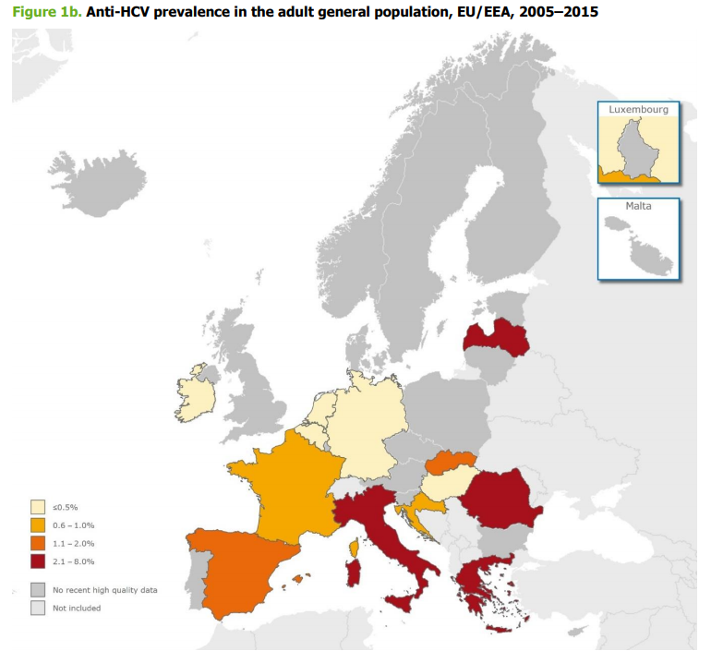
HCV in Europe
In the EU/EEA, the prevalence of HCV is estimated to be around 1.1% with a total of 5.6 million cases of chronic HCV.
Source: European Centre for Disease Prevention and Control. Systematic review on hepatitis B and C prevalence in the EU/EEA. Stockholm: ECDC; 2016.

Slide 17
HCV in Europe
HCV RNA prevalence in countries with data representing the general population
Country | HCV RNA prevalence (%)
Austria
Belgium | 0.1
Bulgaria | -
Croatia | 0-0.9
Cyprus | -
Czech Republic | -
Denmark | -
Estonia | -
Finland | -
France | 0.8-0.9
Germany | 0.3-1.0
Greece | 2.2
Hungary | 0.5
Iceland | 0.9
Ireland | 0.1
Italy | 0.6-27.6
Country | HCV RNA prevalence (%)
Latvia | 2.4
Liechtenstein | -
Lithuania | 2.9
Luxembourg | -
Malta | -
Netherlands | 0.1-1.1
Norway | -
Poland | 0.9-2.9
Portugal | -
Romania | 3.2
Slovakia | 2.0
Slovenia | -
Spain | 0.4-1.5
Sweden | -
United Kingdom | 0.4-1.2
Source: European Centre for Disease Prevention and Control. Hepatitis B and C epidemiology in selected population groups in the EU/EEA. Stockholm: ECDC; 2018.

Slide 18
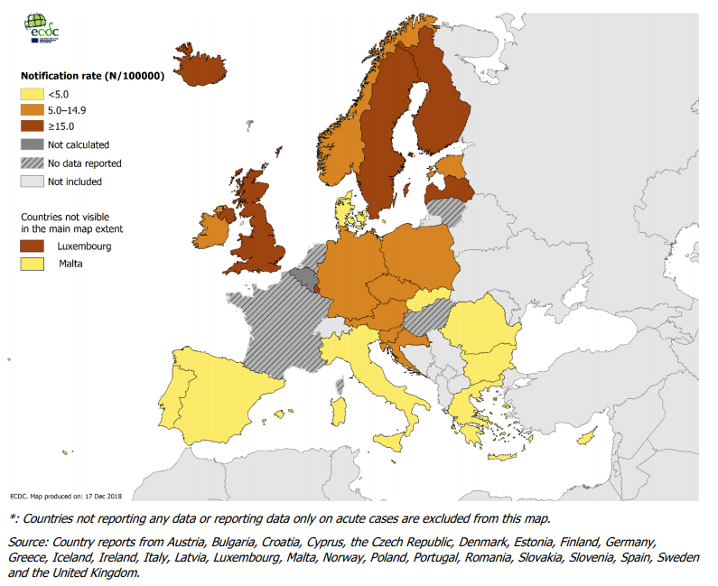
HCV in Europe
Notification rate of newly diagnosed hepatitis C cases per 100 000 population by country*,
EU/EEA, 2017
In 2017, 31 273 cases of hepatitis C were reported in 29 EU/EEA Member States. Of the cases reported, 3% were classified as acute, 22% as chronic and 75% as ‘unknown’.
Source: European Centre for Disease Prevention and Control. Hepatitis C. In: ECDC. Annual epidemiological report for 2017. Stockholm: ECDC; 2019.

Slide 19
HCV in Europe
High risk groups for acquiring an HBV or HCV infection include: people who require blood or blood products, people interned in prisons, people who inject drugs, people with multiple sexual partners, migrants originating from endemic regions, and new-borns from HBV or HCV chronically infected mothers (vertical transmission)
Additional populations identified with HCV prevalence estimates above the 2% threshold and likely to be at a high risk of HCV and/or have a high burden of disease:
PWID
PWID with multiple risks (PWID in prison, PWID living with HIV, and homeless PWID)
Dialysis/haemodialysis patients
Recipients of Substances of human origin (SoHO)
Diabetics
People in prison
People in prison with multiple risks (PWID in prison, PLHIV in prison)
PLHIV
PLHIV with multiple risks (PWID living with HIV, MSM living with HIV, PLHIV in prison)
Infants of mothers with chronic hepatitis C
Family members of people with chronic hepatitis C
Sources: European Centre for Disease Prevention and Control. Systematic review on hepatitis B and C prevalence in the EU/EEA. Stockholm: ECDC; 2016.
European Centre for Disease Prevention and Control. Hepatitis B and C epidemiology in selected population groups in the EU/EEA. Stockholm: ECDC; 2018

Slide 20
Know your HBV epidemic Template slide for your national data
Populate this slide with the below:
Number of new acute and chronic diagnoses per year
Total number of people living with chronic HBV
Key populations at higher risk of HBV
Geographical spread
Time trends
National HBV testing guidelines (if available)
Useful resources:
ECDC technical report: Hepatitis B and C epidemiology in selected population groups in the EU/EEA (2018)
ECDC scientific advice: Systematic review on hepatitis B and C prevalence in the EU/EEA (2016)
ECDC, Annual Epidemiological Report – Hepatitis B
WHO Europe, Factsheet Hepatitis B

Slide 21
Know your HCV epidemic Template slide for your national data
Populate this slide with the below:
Number of new acute and chronic diagnoses per year
Total number of people living with chronic HCV
Key populations at higher risk of HCV
Geographical spread
Time trends
National HCV testing guidelines (if available)
Useful resources:
ECDC technical report: Hepatitis B and C epidemiology in selected population groups in the EU/EEA (2018)
ECDC scientific advice: Systematic review on hepatitis B and C prevalence in the EU/EEA (2016)
ECDC, Annual Epidemiological Report – Hepatitis C
WHO, Factsheet Hepatitis C

Slide 22
Late presentation for viral hepatitis

Slide 23
Late presentation for viral hepatitis
A better understanding of the testing policies and strategies is needed. In October 2015, a consensus definition of late presentation for viral hepatitis was reached:
Definition 1:
Advanced HBV, HCV or HDV associated liver disease is clinically defined by presence of hepatocellular carcinoma or decompensated cirrhosis (jaundice, hepatic encephalopathy, clinically detectable ascites, variceal bleeding).
Definition 2:
Late presentation of HBV or HCV associated liver disease is defined as a patient with chronic hepatitis B or C and significant fibrosis (≥F3 assessed by APRI score >1.5, FIB-4 >3.25, Fibrotest > 0.59 or alternatively a FibroScan >9.5 kPa) with no previous antiviral treatment.
This definition, if implemented by policy makers, health authorities and researchers, will contribute to understanding the magnitude of the proportion of late presenters for viral hepatitis.
Mauss, S., Pol, S., Buti M., Duffell, E., Gore, C., Lazarus J.V., Logtenberg-van der Grient, H, et al. on behalf of the European consensus working group on late presenation for Viral Hepatitis Care. 2017. “Late Presentation of Chronic Viral Hepatitis for Medical Care: A Consensus Definition.” BMC Medicine 15:92 (April). DOI 10.1186/s12916-017-0856-y

Slide 24
The importance of timely diagnosis of HBV and HCV

Slide 25
Underdiagnosis of HBV and HCV in Europe
In spite of data limitations, there is still widespread recognition that underdiagnosis of HBV and HCV is a major problem
An ECDC systematic review which captured estimates of the undiagnosed fraction of HBV and HCV in the EU/EEA, showed high percentage estimates of those unaware of their infection.
Undiagnosed proportion of HBV and HCV cases in the general population or proxy populations, by EU/EEA country
Source: European Centre for Disease Prevention and Control. Hepatitis B and C epidemiology in selected population groups in the EU/EEA. Stockholm: ECDC; 2018

Slide 26
Why should more people be encouraged to learn their HBV and HCV status?
The public health rationale:
Effective treatments exist!
HBV treatments slow the development of cirrhosis, reduce liver cancer and improve long-term survival
Newest HCV treatments can cure the vast majority of cases of chronic HCV
World Health Organization. Guidelines for the prevention, care and treatment of persons with chronic Hepatitis B Infection. Geneva: WHO; 2015.
World Health Organization. Guidelines for the care and treatment of persons diagnosed with chronic hepatitis C virus infection. Geneva: WHO; 2018.

Slide 27
Why should more people be encouraged to learn their HBV and HCV status?
The public health rationale:
2. People with chronic HBV and HCV will not access treatment if they do not know it is needed
HBV and HCV both can remain asymptomatic while causing progressively worse liver damage over many years
Learning about chronic infection early may enable people to initiate treatment in time to interrupt this process

Slide 28
Why should more people be encouraged to learn their HBV and HCV status?
The public health rationale:
Prevention benefit
People who are aware that they have chronic HBV and HCV may be more likely to take measures to prevent onward transmission of the infection

Slide 29
Timely diagnosis of HBV: economic considerations
HBV treatment is cost-effective even though it needs to be taken indefinitely
This conclusion is supported by studies from numerous countries including:
Belgium
Brazil
China
Italy
Poland
Spain
United Kingdom
United States
Others …
Buti, María, Itziar Oyagüez, Virginia Lozano, and Miguel A. Casado. 2013. “Cost Effectiveness of First-Line Oral Antiviral Therapies for Chronic Hepatitis B : A Systematic Review.” PharmacoEconomics 31 (1): 63–75. doi:10.1007/s40273-012-0009-2.

Slide 30
Timely diagnosis of HCV: economic considerations
The newest HCV drugs are expensive – but this does not mean they are entirely inaccessible to people who need them
The newest HCV drugs are highly effective – and curing HCV means reducing costly health problems such as liver cancer and liver transplant
Many people are advocating for prices to be lowered
Meanwhile, even at current prices, analyses from several countries demonstrate cost-effectiveness
France (Leleu, H., M. Blachier, and I. Rosa. 2015. “Cost-Effectiveness of Sofosbuvir in the Treatment of Patients with Hepatitis C.” Journal of Viral Hepatitis 22 (4): 376–83. doi:10.1111/jvh.12311.)
Germany (Gissel, Christian, Georg Götz, Jörg Mahlich, and Holger Repp. 2015. “Cost-Effectiveness of Interferon-Free Therapy for Hepatitis C in Germany--an Application of the Efficiency Frontier Approach.” BMC Infectious Diseases 15: 297. doi:10.1186/s12879-015-1048-z.)
Switzerland (Pfeil, Alena M., Oliver Reich, Ines M. Guerra, Sandrine Cure, Francesco Negro, Beat Müllhaupt, Daniel Lavanchy, and Matthias Schwenkglenks. 2015. “Cost-Effectiveness Analysis of Sofosbuvir Compared to Current Standard Treatment in Swiss Patients with Chronic Hepatitis C.” PloS One 10 (5): e0126984. doi:10.1371/journal.pone.0126984. )
United Kingdom (Cure, S., I. Guerra, and G. Dusheiko. 2015. “Cost-Effectiveness of Sofosbuvir for the Treatment of Chronic Hepatitis C-Infected Patients.” Journal of Viral Hepatitis, April. doi:10.1111/jvh.12409.)

Slide 31
Barriers to HBV and HCV testing

Slide 32
Barriers to HBV and HCV testing
Systemic factors that may affect access to testing:
Lack of national strategic planning for viral hepatitis
Lack of legal framework for national screening strategies and treatment
Criminalisation of drug use
Societal stigma and discrimination against people with HCV and/or PWID.
Source: Sperle I, Hedrich D, Palczak K, Singleton N, Zimmermann R. Barriers to HCV testing in drug treatment services for people who inject drugs. Poster session presented at: 7th International Symposium on Hepatitis Care in Drug Users; 2018 19-21 Sep; Cascais, Portugal.

Slide 33
Barriers to HBV and HCV testing
Provider-level factors that may affect access to testing:
Lack of provider knowledge of HCV
Insufficient staff available to offer and provide testing services
Lack of time to offer testing and the high cost of testing
Source: Sperle I, Hedrich D, Palczak K, Singleton N, Zimmermann R. Barriers to HCV testing in drug treatment services for people who inject drugs. Poster session presented at: 7th International Symposium on Hepatitis Care in Drug Users; 2018 19-21 Sep; Cascais, Portugal.

Slide 34
Barriers to HBV and HCV testing
Factors on the client-level that may pose as barriers to testing:
Low risk perception of HCV
Lack of information about where to go for testing
Lack of accessible testing
Stigma and discrimination
Fear of consequences of a positive test result
Source: Sperle I, Hedrich D, Palczak K, Singleton N, Zimmermann R. Barriers to HCV testing in drug treatment services for people who inject drugs. Poster session presented at: 7th International Symposium on Hepatitis Care in Drug Users; 2018 19-21 Sep; Cascais, Portugal.

Slide 35
Barriers to HBV and HCV testing Template slide on country situation
Populate this slide with the below, using any available evidence from the national or local level
What are the barriers to patients asking for an HBV or HCV test?
What are the barriers to healthcare providers offering an HBV or HCV test?
What are other barriers?

Slide 36
Creating more testing opportunities

Slide 37
Creating more testing opportunities
The WHO guidelines states that effective interventions that increase testing uptake, improve linkage and retention in care and provide preventative care should vary and depend on the local context, including the health-care delivery system, geography and target population. WHO recommends four key components to increase update of testing:
Promotion of HBV testing by lay health workers
Clinician reminders to prompt HCV testing during clinical visits
Integrated care between mental health and HCV treatment specialists
Interventions to promote linkage to care for HIV
Source: World Health Organization. WHO guidelines on hepatitis B and C testing. Geneva: World Health Organization; 2017.

Slide 38
Creating more testing opportunities
Factors that may increase access to testing in some health care settings include:
Integration with other health services (e.g. HIV)
Decentralisation of testing to other health care settings (including primary care, HIV, tuberculosis or STI clinics, drug treatment and harm reduction services and inpatient and outpatient hospital settings)
Task sharing of testing responsibilities to other health workers, including trained lay providers.
Source: World Health Organization. WHO guidelines on hepatitis B and C testing. Geneva: World Health Organization; 2017.

Slide 39
Creating more testing opportunities
Community-based testing can help reach certain at-risk populations. Evidence for community-based testing interventions include examples that utilised:
Mobile/outreach testing through mobile vans or tents at community sites (e.g. churches, mosques, bars, clubs, etc).
Door-to-door/home-based testing
National testing campaigns
Mass media and social media awareness campaigns
Workplace testing
Testing in schools, colleges or other educational establishments
Testing in prions and other correctional system settings
Source: World Health Organization. WHO guidelines on hepatitis B and C testing. Geneva: World Health Organization; 2017.

Slide 40
Creating more testing opportunities: Key principles
Testing programmes should follow international and regional guidelines, including from the WHO and the 2018 ECDC guidance on integrated testing for viral hepatitis and HIV, and adhere to the Guiding principles of testing
World Health Organization. WHO guidelines on hepatitis B and C testing. Geneva: World Health Organization; 2017.
European Centre for Disease Prevention and Control. Public health guidance on HIV, hepatitis B and C testing in the EU/EEA – An integrated approach. Stockholm: ECDC; 2018.

Slide 41
Conclusions

Slide 42
Conclusions
Rationale for HBV and HCV testing
HBV and HCV are major health problems in many European countries
Effective treatment exists!
People will not access treatment if they do not know they need it – they must learn their HBV and HCV status
Knowing may also encourage people to avoid onward transmission

Slide 43
Conclusions
Increasing HBV and HCV testing
Barriers to HBV and HCV testing must be overcome
There are practical measures that governments, health care providers and communities can take to make HBV and HCV testing more accessible to a wider range of people

